Slide 1

New Member Orientation
District 1-D
Notes:
Trainer Tip: Enter additional information as you see fit, such as the name of the New Member Orientation trainer. Use this PowerPoint along with the New Member Orientation Training Guide. Be sure each of your participants has a New Member Orientation Guide to follow along with the presentation.

Slide 2
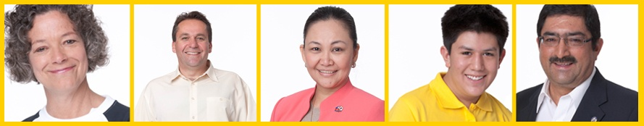
New Member Orientation Summary
New member orientation is broken out into
five sections:
  Membership
  Who Lions Are
  Lions Clubs International (LCI)
  District and Multiple District
  Your Club

Slide 3
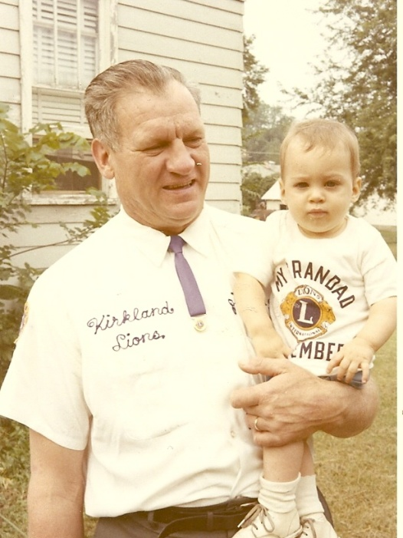
Membership
The benefits of Lions Clubs membership are numerous, and include:
Helping those in need
Making a difference in your community
Having an impact on those in need worldwide
Developing leadership skills
Enhancing communication skills
Utilizing planning and organization skills
Working hands-on to meet community needs
Meeting new people
Opportunities to network
Opportunities to travel
And so much more

Slide 4
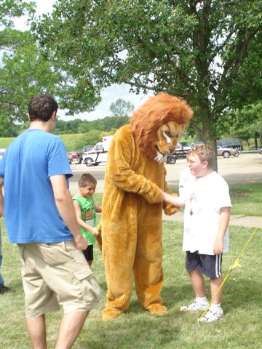
Who Lions Are
Lions are men and women dedicated to serving those in need, whether in their own community or around the world.
  Over 1.4 million members
  Over 200 countries
  More than 48,000 clubs

Slide 5
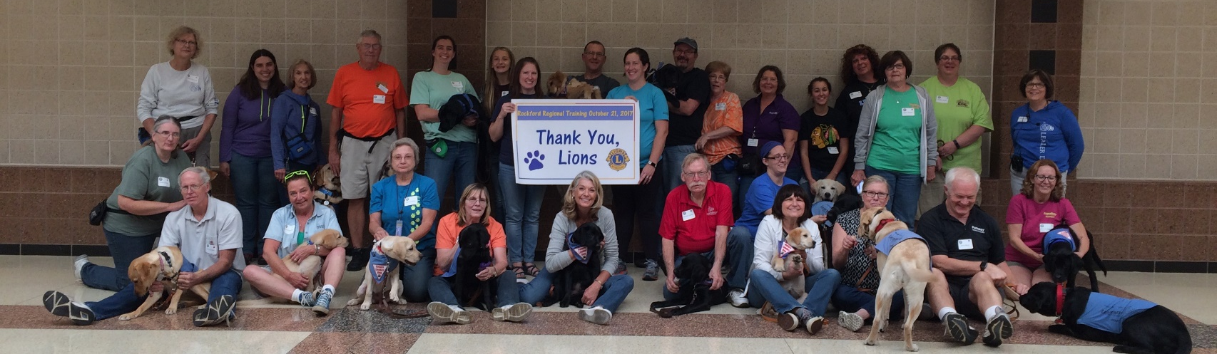
Who Lions Are
Vision Statement: To be the global leader in community and humanitarian service.
Mission Statement: To empower volunteers to serve their communities, meet humanitarian needs, encourage peace and promote international understanding through Lions clubs.
Motto: “We Serve”
Slogan: Liberty, Intelligence, Our Nation’s Safety
Purposes: LCI has a list of purposes to convey why Lions clubs exist.
Code of Ethics: LCI has a code of ethics which set the standard that Lions should aspire to adhere to.

Slide 6
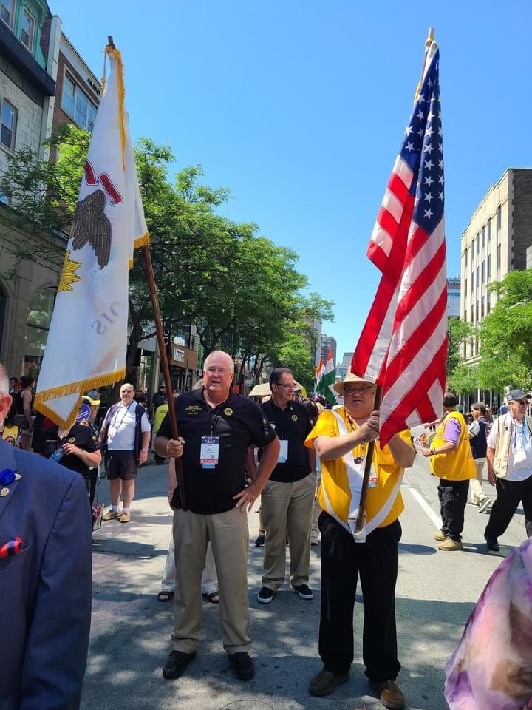
Lionism
Lions Clubs are non-political and non-sectarian
Lions Clubs are composed of business professionals and community minded individuals
Lions Clubs membership: is by invitation only
Lions Clubs are non-political and non-sectarian
Lions Clubs are composed of business professionals and community minded individuals
Lions Clubs membership: is by invitation only

Slide 7
Lion Code of Ethics
Lions Code of Ethics
  To Show my faith in the worthiness of my vocation by industrious application to the end that I may merit a reputation for quality of service.
  To Seek success and to demand all fair remuneration or profit as my just due, but to accept no profit or success at the price of my own self-respect lost because of unfair advantage taken or because of questionable acts on my part.
  To Remember that in building up my business it is not necessary to tear down another's; to be loyal to my clients or customers and true to myself.
  Whenever a doubt arises as to the right or ethics of my position or action towards others, to resolve such doubt against myself.
  To Hold friendship as an end and not a means. To hold that true friendship exists not on account of the service performed by one another, but that true friendship demands nothing but accepts service in the spirit in which it is given.
  Always to bear in mind my obligations as a citizen to my nation, my state, and my community, as to give them my unswerving loyalty in word, act, and deed. To give them freely of my time, labor and means.
  To Aid others by giving my sympathy to those in distress, my aid to the weak, and my substance to the needy.
  To Be Careful with my criticism and liberal with my praise; to build up and not destroy.

Slide 8
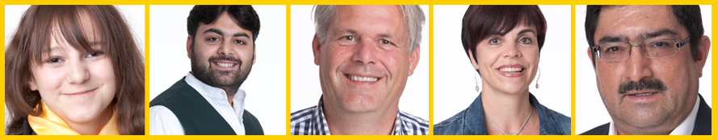
Lions Clubs International

Slide 9
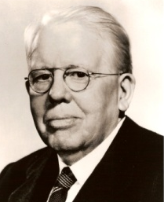
History
1917: Melvin Jones founded LCI.
1920: LCI becomes international with Canadian club.
1925: Helen Keller challenged Lions to become “knights of the blind.”
1945: LCI helped draft the United Nations Charter.
1957: The Leo Club Program is created.
1968: The Lions Clubs International Foundation is established.
1990: SightFirst is launched.
Today: Our international network has grown to include more than 200 countries and geographic areas.
1987: LCI became the first service club organization to admit women as members.

Slide 10

Name and Logo
The official name of the association is “The International Association of Lions Clubs” or simply “Lions Clubs International.”
The name Lions was chosen on a secret ballot over several others because the lion stood for strength, courage, fidelity and vital action.
The Lions logo consists of a gold “L” on a blue field surrounded by a gold circle. On either side of the circle is the profile of a Lion’s head, one looking back upon a proud past and the other looking optimistically toward the future.

Slide 11
Organizational Structure
International officers implement policy and serve as inspirational leaders of the world’s Lions.
  International President: Brian Sheehan Bird Island, Minnesota, USA
  First Vice President: Dr. Patti Hill Edmonton, Alberta, Canada
  Second Vice President: Fabricio Oliveira Catole do Rocha, Brazil
  Third Vice President: AP Singh Kolkata, WB, India
  Immediate Past President/LCIF Chairperson: Douglas X. Alexander, Brooklyn, NY, USA
The International Board of Directors is the governing body of the association.
  34 members
The International Constitution and By-Laws govern the operations of the association and establish the rules by which the association is to function.

Slide 12
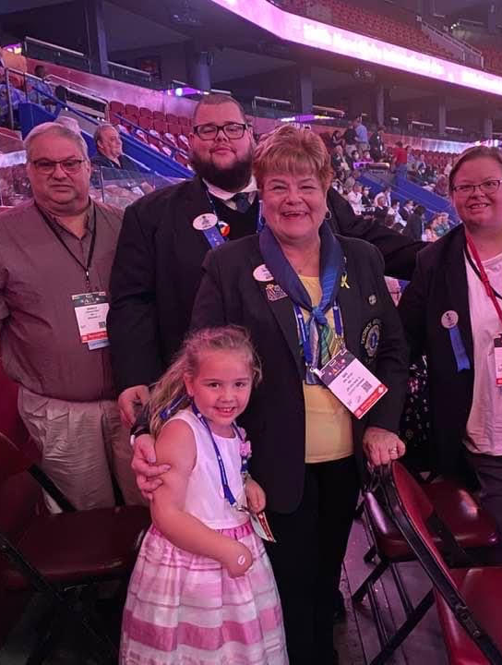
International Convention
Convention brings together thousands of Lions from around the world for a week of business, education, celebration and fellowship.
  July 7-11, 2023: Boston, Massachusetts
  June 21-25, 2024: Melbourne, Australia
  July 4-8, 2025: Mexico City, Mexico
  July 3-7, 2026: Atlanta, Georgia
  July 2-6, 2027: Washington, DC
  June 23-27, 2028: Singapore

Slide 13
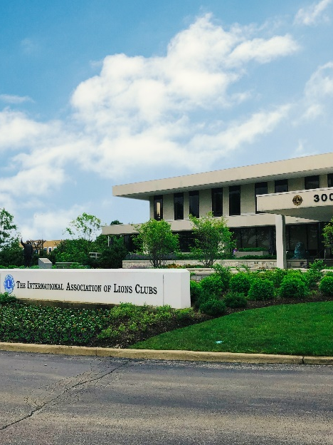
International Headquarters
Located in Oak Brook Illinois
Approximately 275 staff members
in 11 divisions:
  Convention
  District and Club Administration
  Finance
  Information Technology
  Leadership Development
  Legal
  Lions Clubs International Foundation
  Marketing
  Membership
  Member Operations and Support
  Service Activities

Slide 14
Lions Clubs International Foundation (LCIF)
Important Facts
  Founded in 1968: official foundation of Lions Clubs International, empowering the service of Lions
  Provides grant funding for large-scale humanitarian projects
  Relies on donations
  More than US$1 billion in grants awarded to date
  Amidst the most ambitious fundraising campaign in its history

Slide 15
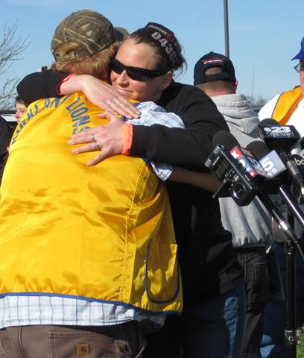
Lions Clubs International Foundation (LCIF)
50+ Years of Impact
  US$120 million in disaster relief funding
  16 million children served by Lions Quest
  9.1 million cataract surgeries
  Millions of children vaccinated against
  measles

Slide 16
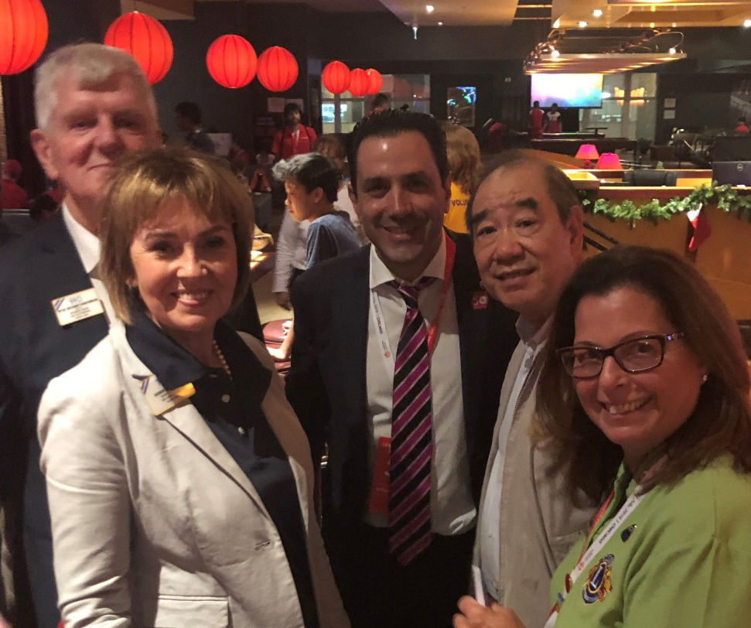
Leadership
LCI provides training and development opportunities for Lions. The Global Leadership Team (GLT) is the driving force behind these programs, including:
  Emerging Lions Leadership Institutes
  Advanced Lions Leadership Institutes
  Faculty Development Institutes
  Regional Lions Leadership Institutes
  District Governors-Elect Seminar
  Multiple District Leadership Development
  Funding
  GLT District Funding Support Program
  Webinars
  Lions Learning Center
  Lions Certified Instructor Program

Slide 17


Service Activities
Because Lions seek to address the greatest needs in their communities, our activities are varied, although Lions are united behind five global causes. The Global Service Team (GST) is the driving force behind these programs and collects and shares service stories that empower leaders to act.
  Diabetes
  Vision
  Hunger
  Environment
  Childhood Cancer & Youth

Slide 18
Membership Development
Recruiting new members into your club ensures that there will be a continual influx of enthusiastic members to serve those in need and identify new service that can be done in your community. Membership programs designed to help stimulate growth and foster quality members include:
  Family Membership
  Student Membership
  Leo to Lion
  Lions Worldwide Induction Day
  Leo Clubs
  Club Branches
In addition, forming new clubs is essential to serving a new or underserved area. Membership has several club types to help every member find the right fit:
  Traditional Lions clubs
  Campus Lions clubs
  Leo Lions clubs
  Lioness Lions clubs
  Specialty Lions clubs

Slide 19

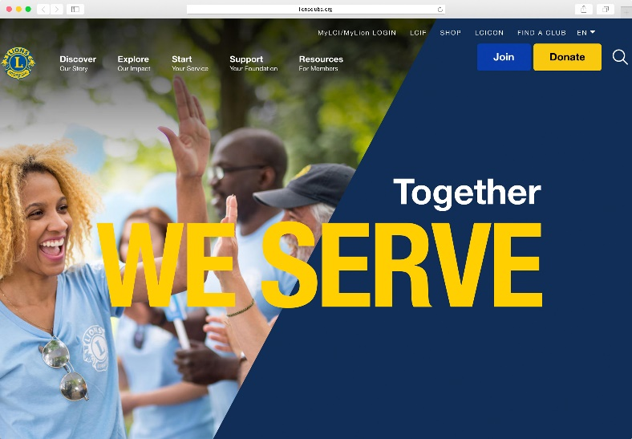
Communications
LION Magazine
E-mail Messages
Website
  lionsclubs.org
Social Networking
  Facebook
    facebook.com/lionsclubs
  Twitter
    twitter.com/lionsclubs
  YouTube
    youtube.com/lionsclubs

Slide 20
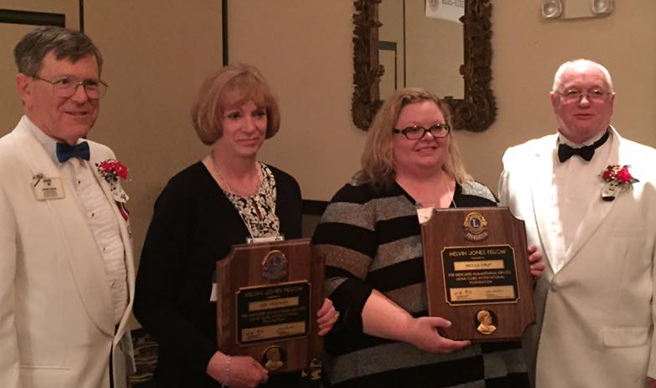
District and Multiple District

Slide 21
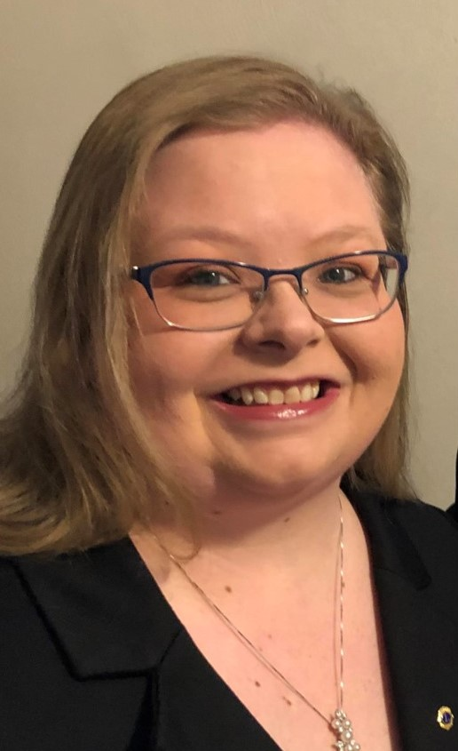
Organizational Structure
There about 750 districts with 35 or more clubs and at least 1,250 members in each district.
  Each district has a district governor
  2022-2023 DG Nicole Fruit
Multiple districts are formed by two or more districts within a territory.
Our Multiple District: MD1 (10 districts)
Our District: 1-D (6 zones)
Notes:
Trainer Tip: Consider adding additional information about your district and multiple district, such as boundaries of your district and multiple district.

Slide 22
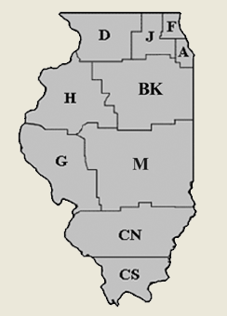
Multiple District 1 is Illinois
MD 1
Multiple District 1 represents the Lions organization in 10 Districts in the State of Illinois.
District 1-D is located in the Northwest corner of Illinois. Runs along the Mississippi River to the Wisconsin border, then to as far east as Marengo, and as far south as Paw Paw.

Slide 23

Lions of Illinois Foundation
Foundation created by MD-1 to operate statewide service projects.
Vision Statement
The Vision of the Lions of Illinois Foundation is to Create a Permanent Vehicle for the Delivery of Programs and Services to People With Vision and Hearing Needs.

Slide 24
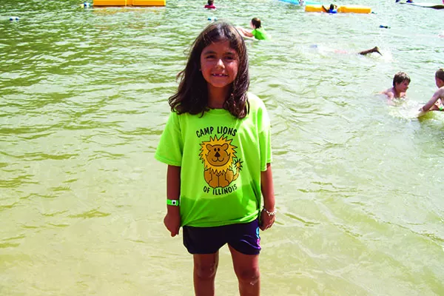
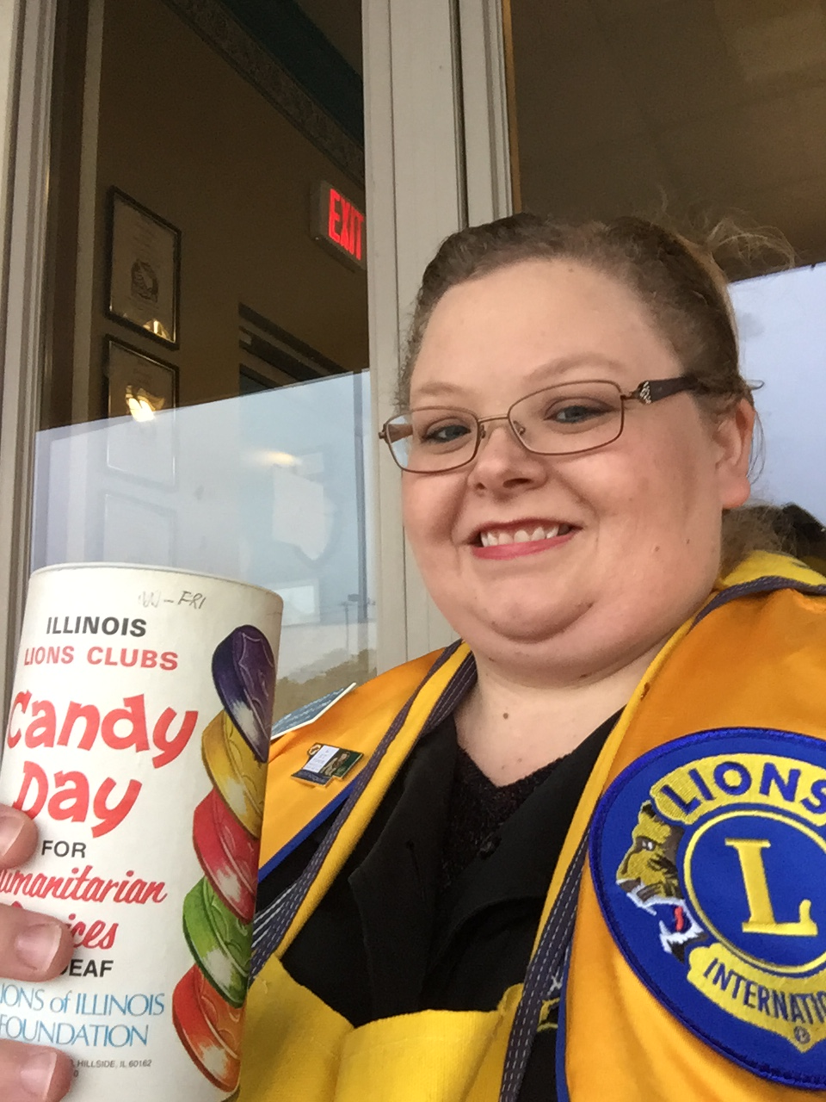
LIF Service Projects & Fundraisers
Service Projects
  Camp Lions
  Hearing
  Recycling
  Student Low Vision Screening
  Adult Low Vision Screening
  Mobile Screening Units
Fundraisers
  Candy Day
  LIF Gift Card Campaign
  Sight & Sound Sweepstakes
  Tootsie Pop Day
  A Knight’s Quest Gala
  Birdies for Charity
  Terri Lynn
  Car Shows

Slide 25
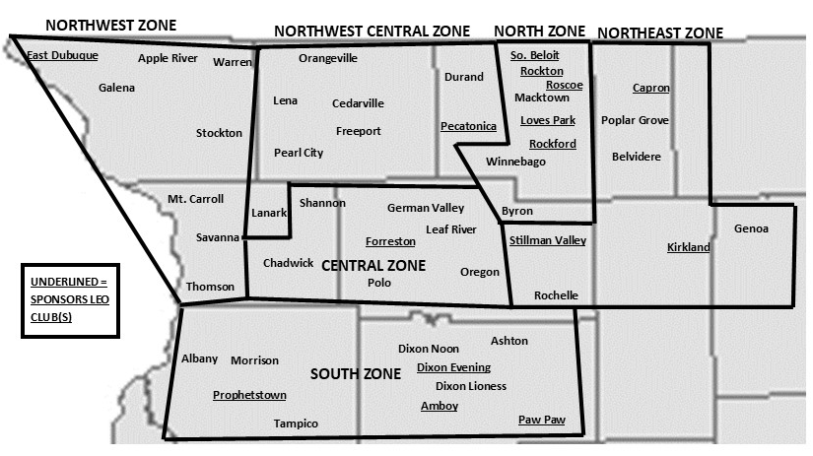
District 1-D: 6 Zones

Slide 26
District Leadership
District Governor: Nicole Fruit
First Vice District Governor: Duane Collman
Second Vice District Governor: Lonna Bentley
Cabinet Secretary-Treasurer: CS—Barb Sager; CT—Edy Pfeiffer
Zone Chairperson: Central—Lion Bob Cushman
Global Action Team:
  Global Action Team District Chairperson (District Governor): DG Nicole Fruit
  Global Membership Approach Coordinator: PDG Tami Verstraete
  Global Membership Team District Coordinator: PCC Pam Graney
  Global Leadership Team District Coordinator: PDG Ron Fruit
  Global Service Team District Coordinator: Lion Sara Burbank
Notes:
Trainer Tip: Briefly go over the roles of each of these positions. The roles are found in the trainer and participant’s guide.

Slide 27
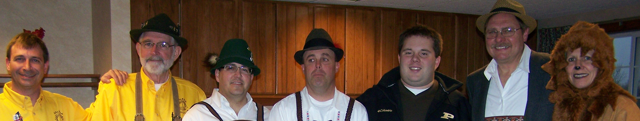
District Convention
District conventions are held to:
  Develop fellowship among the Lions of the district
  Conduct general district business
  Elect the district governor and other district-elected
  officers
  Conduct seminars
March 24 & 25, 2023
Rockford, IL Radisson Hotel & Convention Center
Voting on Saturday
Friday night—Lion Roar Challenge & games

Slide 28
How the District and Multiple District Communicate
District Website: www.district1dlions.com
District 1D Facebook Page: https://www.facebook.com/IllinoisDistrict1DLions
Center for Sight & Hearing Website: www.cshni.org
Center for Sight & Hearing Facebook Page: https://www.facebook.com/CenterForSightandHearing/
Lions of Illinois Foundation (LIF) Website: www.LionsofIllinoisFoundation.org
Lions of Illinois Foundation (LIF) Facebook Page: https://www.facebook.com/LIFnd/
Multiple District 1 Lions: http://illinoislionsmd1.org/
MD 1 Illinois State Council of Governors Facebook Page: https://www.facebook.com/MD1LIONS/
State Secretary-Treasurer: sst@illinoislionsmd1.org

Slide 29
Acronyms and Terms to Remember
PP—past president
ZC—zone chairperson
VDG—vice district governor
DG—district governor
PCC—past council chairperson
PDG—past district governor
PID—past international director
GLT—Leadership Chairperson
GMT—Membership Chairperson
GST—Service Chairperson
GMA—Global Membership Approach
LCI—Lions Clubs International
LCIF—Lions Clubs International Foundation
LIF—Lions of Illinois Foundation
LIEF—Lions of Illinois Endowment Fund
1D—refers to the district in which we are located
MD-1—Multiple District 1 (an association of the 10 districts in Illinois)

Slide 30
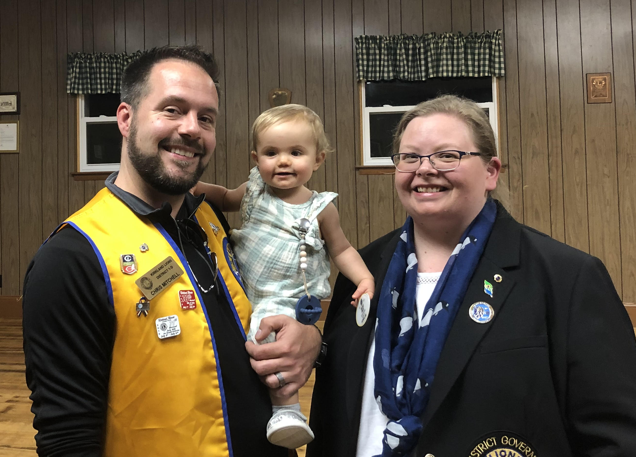
YOUR LIONS CLUB SLIDES

Slide 31
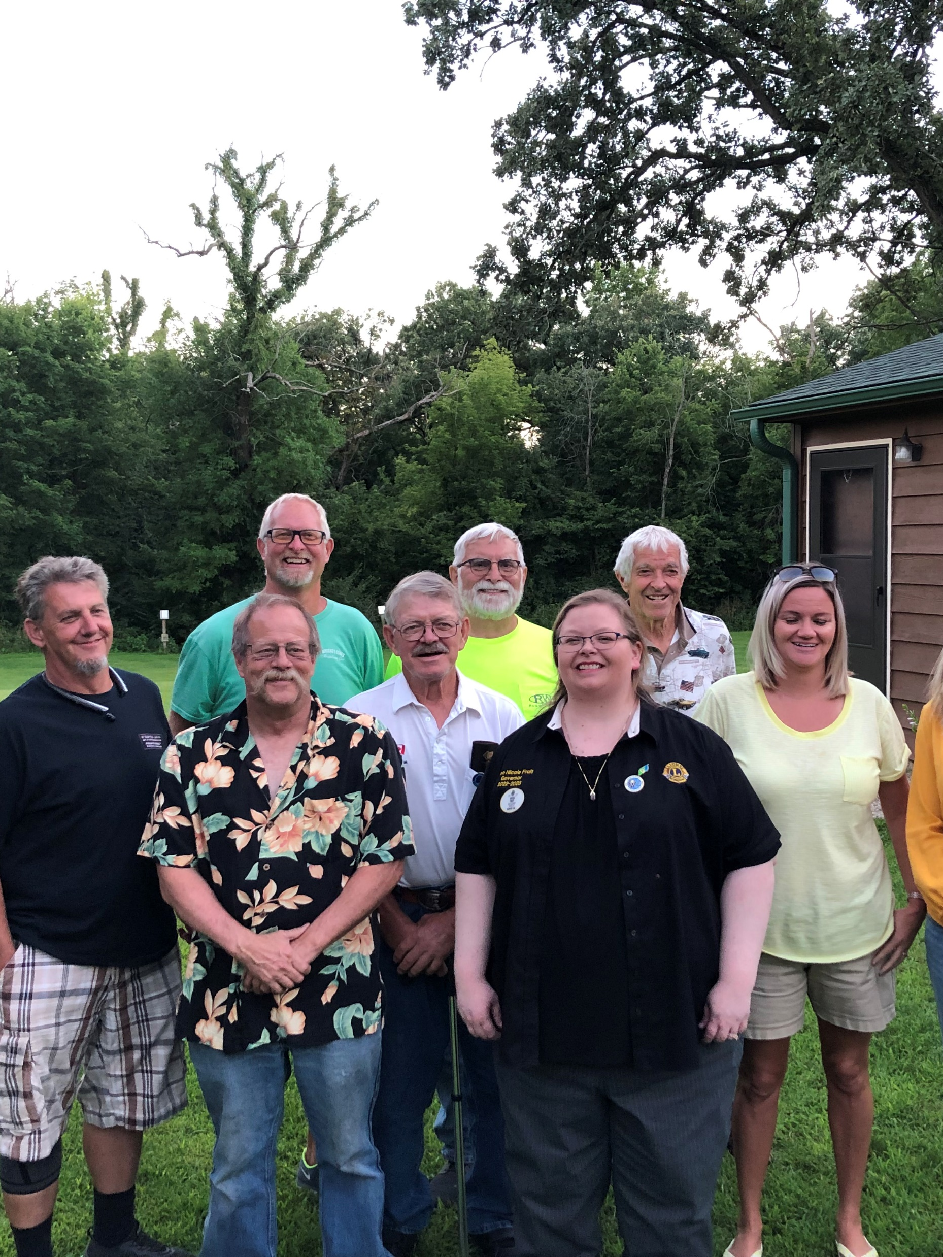
Club History
Year chartered:
Number of charter members:
Clubs sponsored by us:
Significant awards or achievements:
Notes:
Trainer Tip: Edit this slide as you see fit. Remove things that don’t apply to your club, or add things that are not currently included.

Slide 32
Club Officers
2 Year Director
Membership
Secretary
3rd Vice President
1 Year Director
Board of Directors
President
1st Vice President
2 Year Director
Treasurer
2nd Vice President
1 Year Director
Notes:
Trainer Tip: Add the names of the current club officers. Add or remove bullet points if your club has different officers than those listed.

Slide 33
Club Officer List
President:
Immediate Past President:
Vice President:
Secretary:
Treasurer:
Membership Chairperson:
Service Chairperson:
Marketing Chairperson:
Lion Tamer:
Tail Twister:
1-Year Directors:
2-Year Directors:
President:
Immediate Past President:
Vice President:
Secretary:
Treasurer:
Membership Chairperson:
Service Chairperson:
Marketing Chairperson:
Lion Tamer:
Tail Twister:
1-Year Directors:
2-Year Directors:

Slide 34
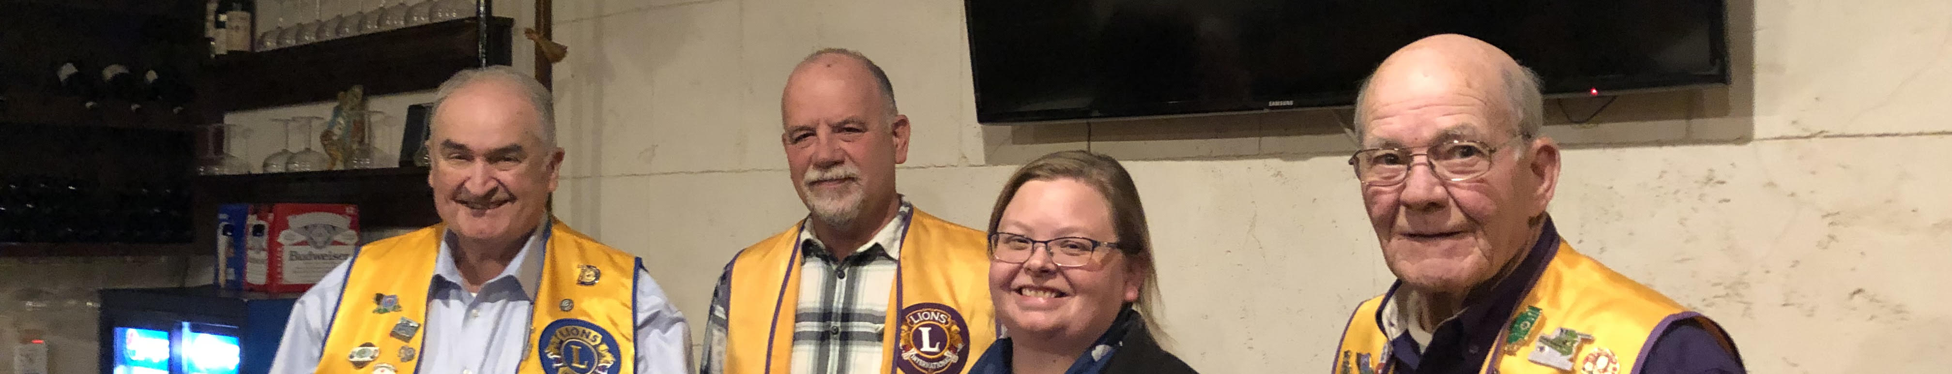
Elections
Officers are elected annually
Club president appoints a nomination committee in March
The nomination committee selects candidates
The club votes on in April
The term begins July 1st

Slide 35
Sample Agenda
Call to Order
Pledge
Invocation
Introduction of Guests
Dinner (Thank Cooks)
Secretary's Report
Treasurer’s Report
Guest Speaker
Unfinished Business
New Business
Tail Twister
Adjournment

Slide 36
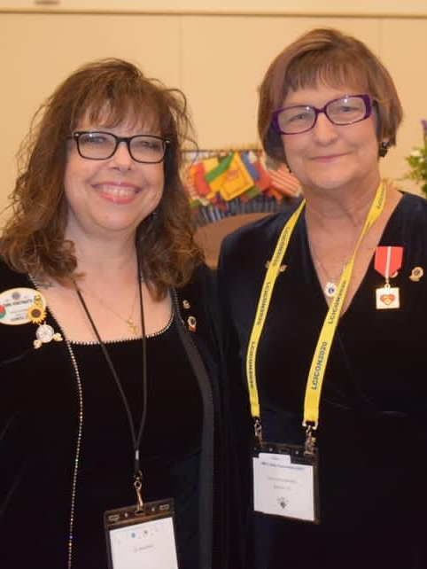
Awards
While service is its own reward, special accomplishments and milestones should be recognized and celebrated. The awards below are awards that all Lions can achieve.
Membership Keys
Chevrons
Member Sponsor Recognition
Extension Awards
Melvin Jones Fellow (LCIF)
Foundation Fellow (LIF)
Leadership & Presidential Metals (LCI)
Certificates of Appreciation (DG)
Notes:
Trainer Tip: Add additional information to this slide to show additional awards that are available through your club, district or multiple district.

Slide 37
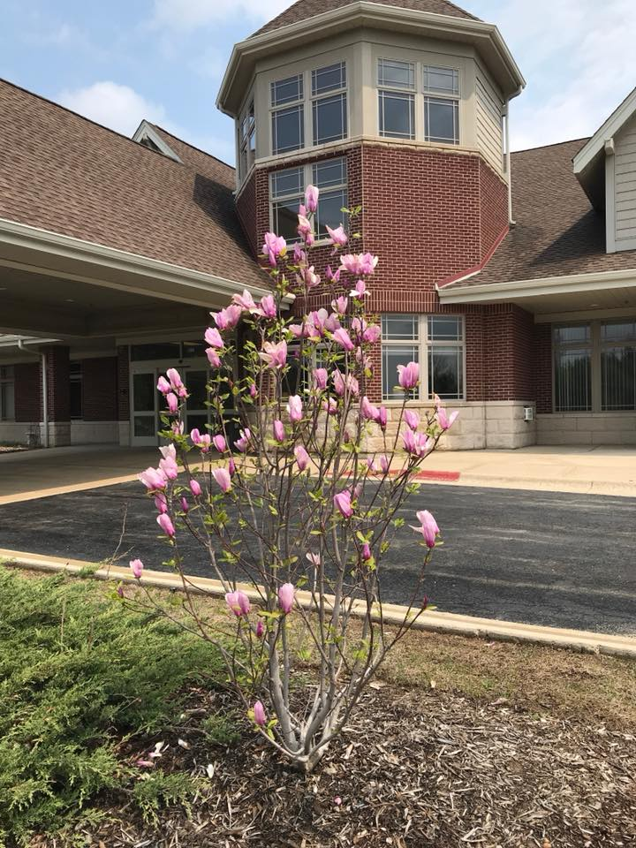
Service and Fundraising Activities
Service Projects and Fundraising Activities
  List the Various Service Projects and Fundraising Activities your club does and did in the past
Notes:
Trainer Tip: Consider adding photos from the projects to the slide if they are available.

Slide 38
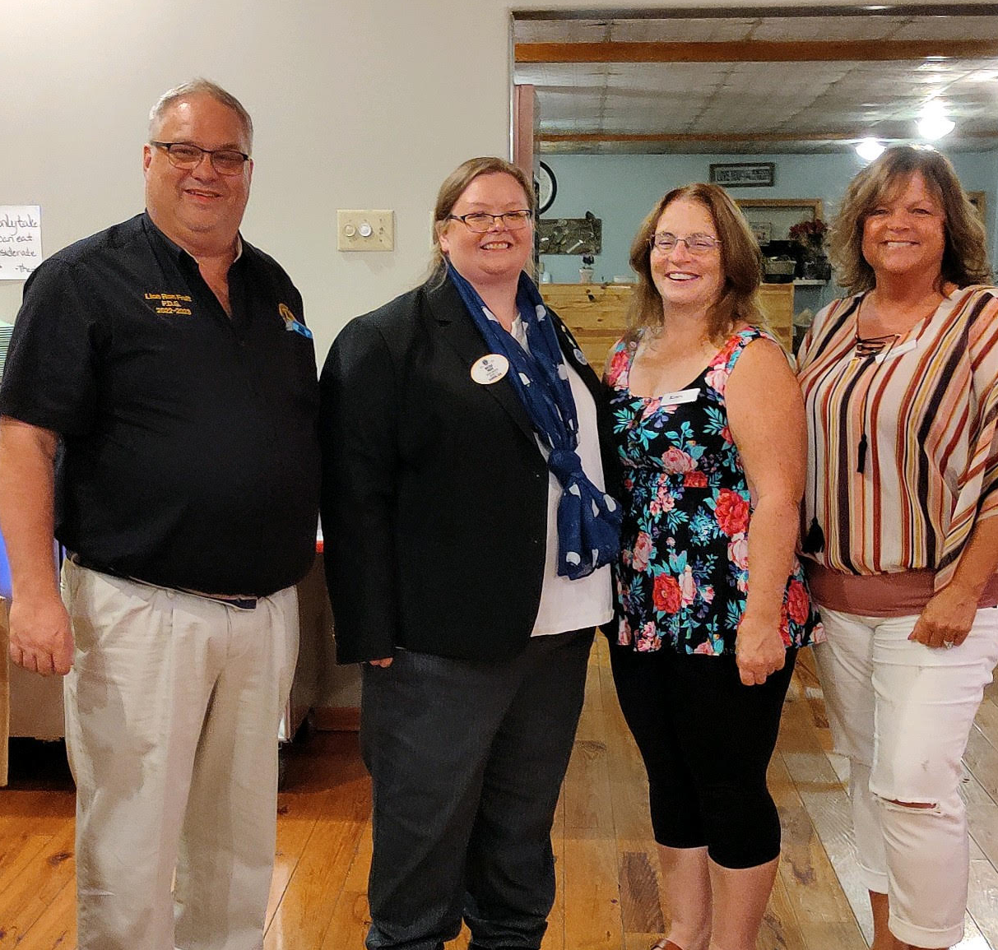
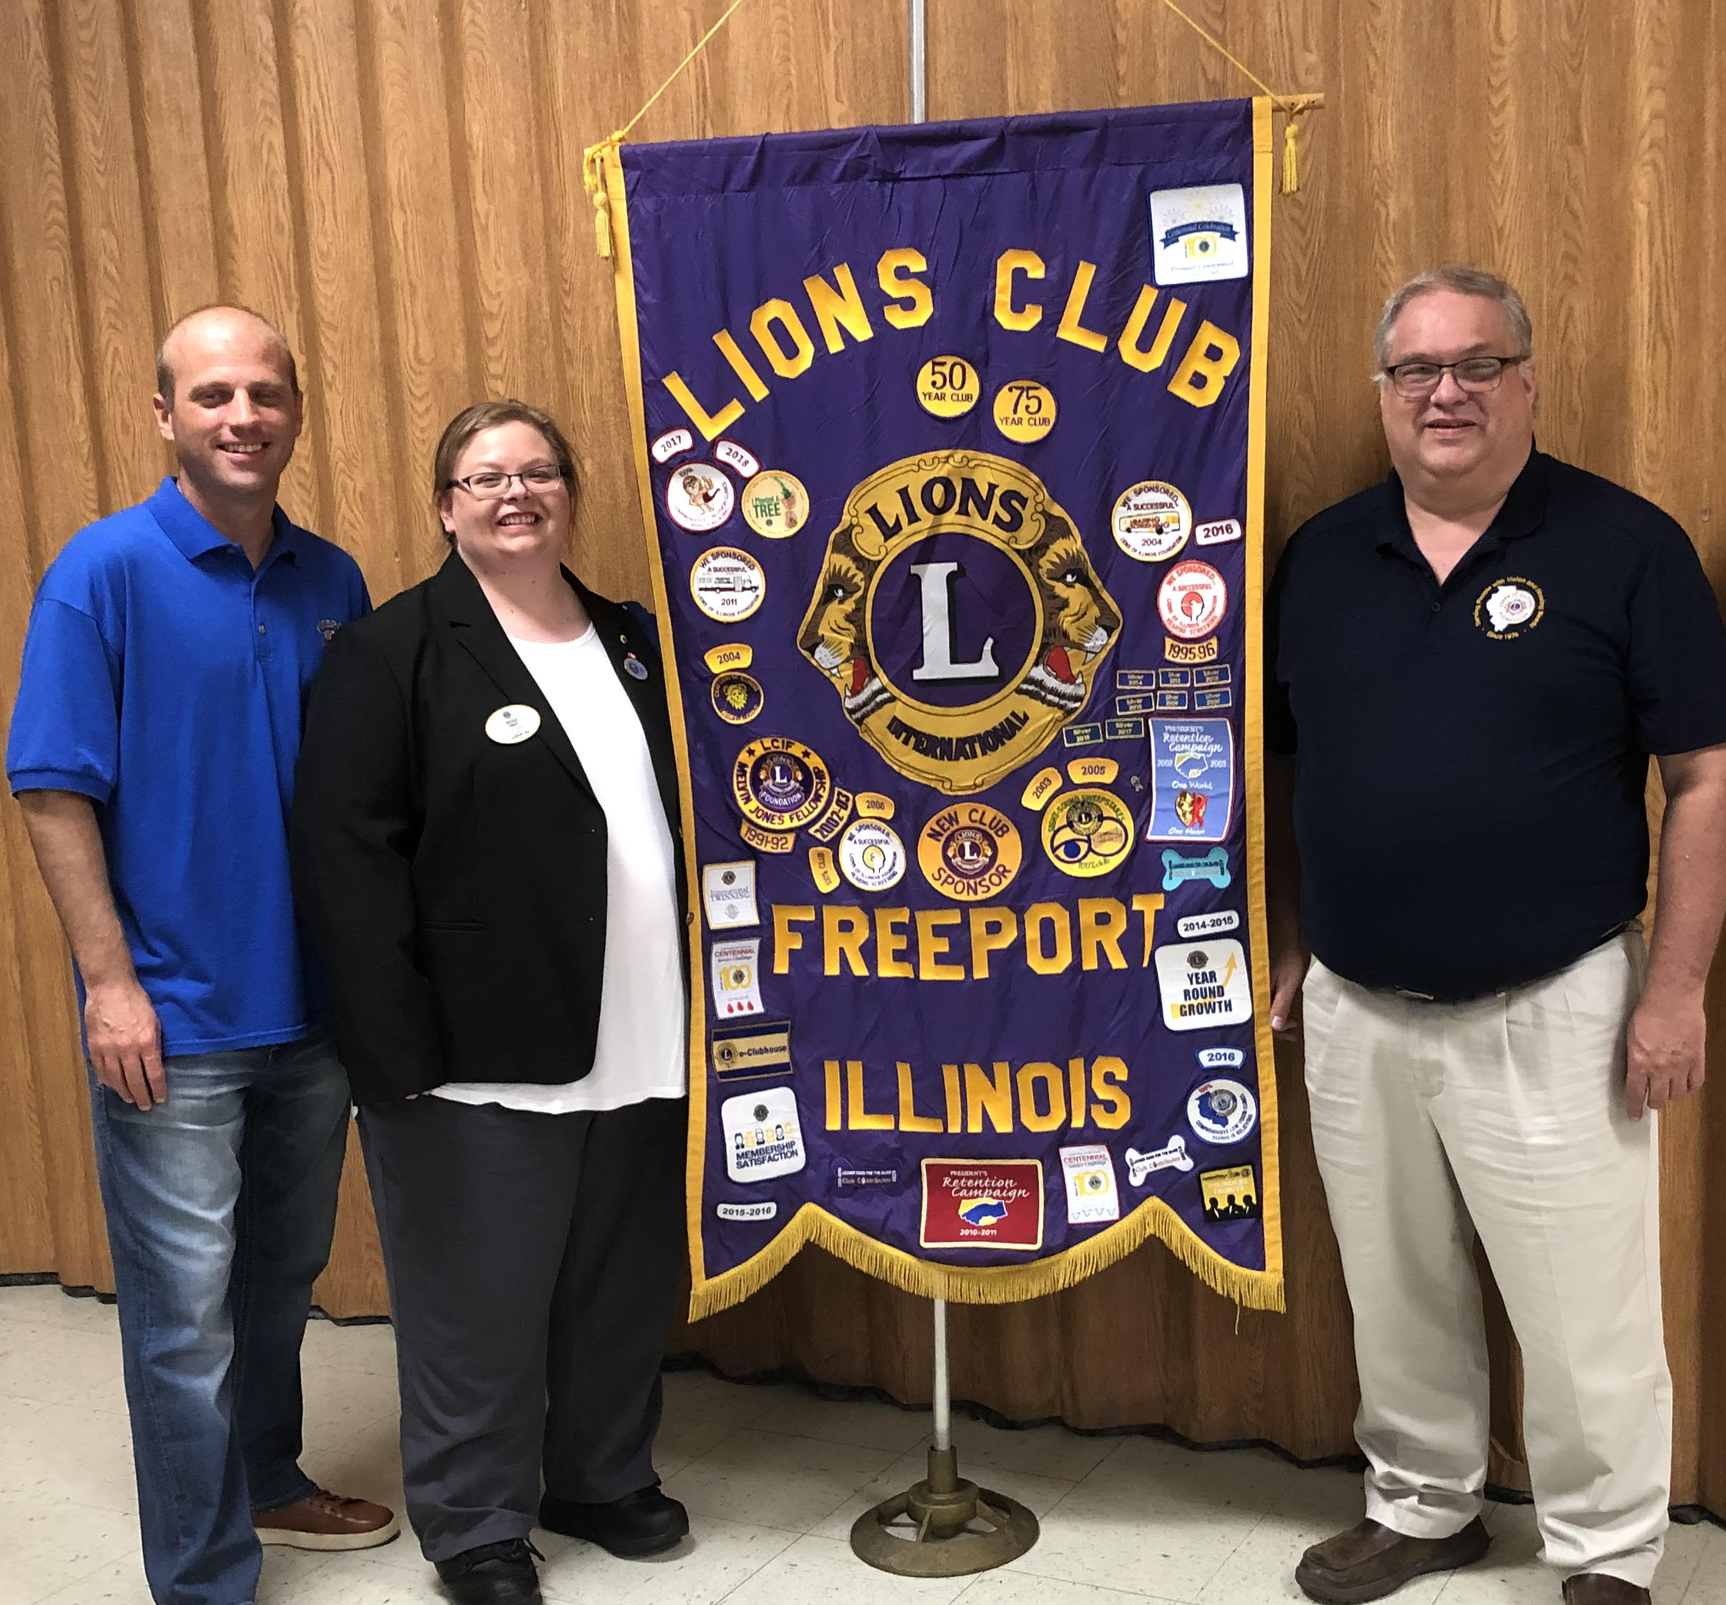
Meetings
When:
Where:
Notes:
Trainer Tip: Add any additional meeting information you feel is important.

Slide 39

Dues and Budgets
Total Dues
  Club dues:
  District and multiple district dues:
  International dues:
Activities Budget
Administrative Budget
Notes:
Trainer Tip: Explain that the activities budget consists of funds raised form the public through club projects and may only be expended to satisfy a community or public need. The administrative budget is what finances club operations and comes mostly from club dues.

Slide 40
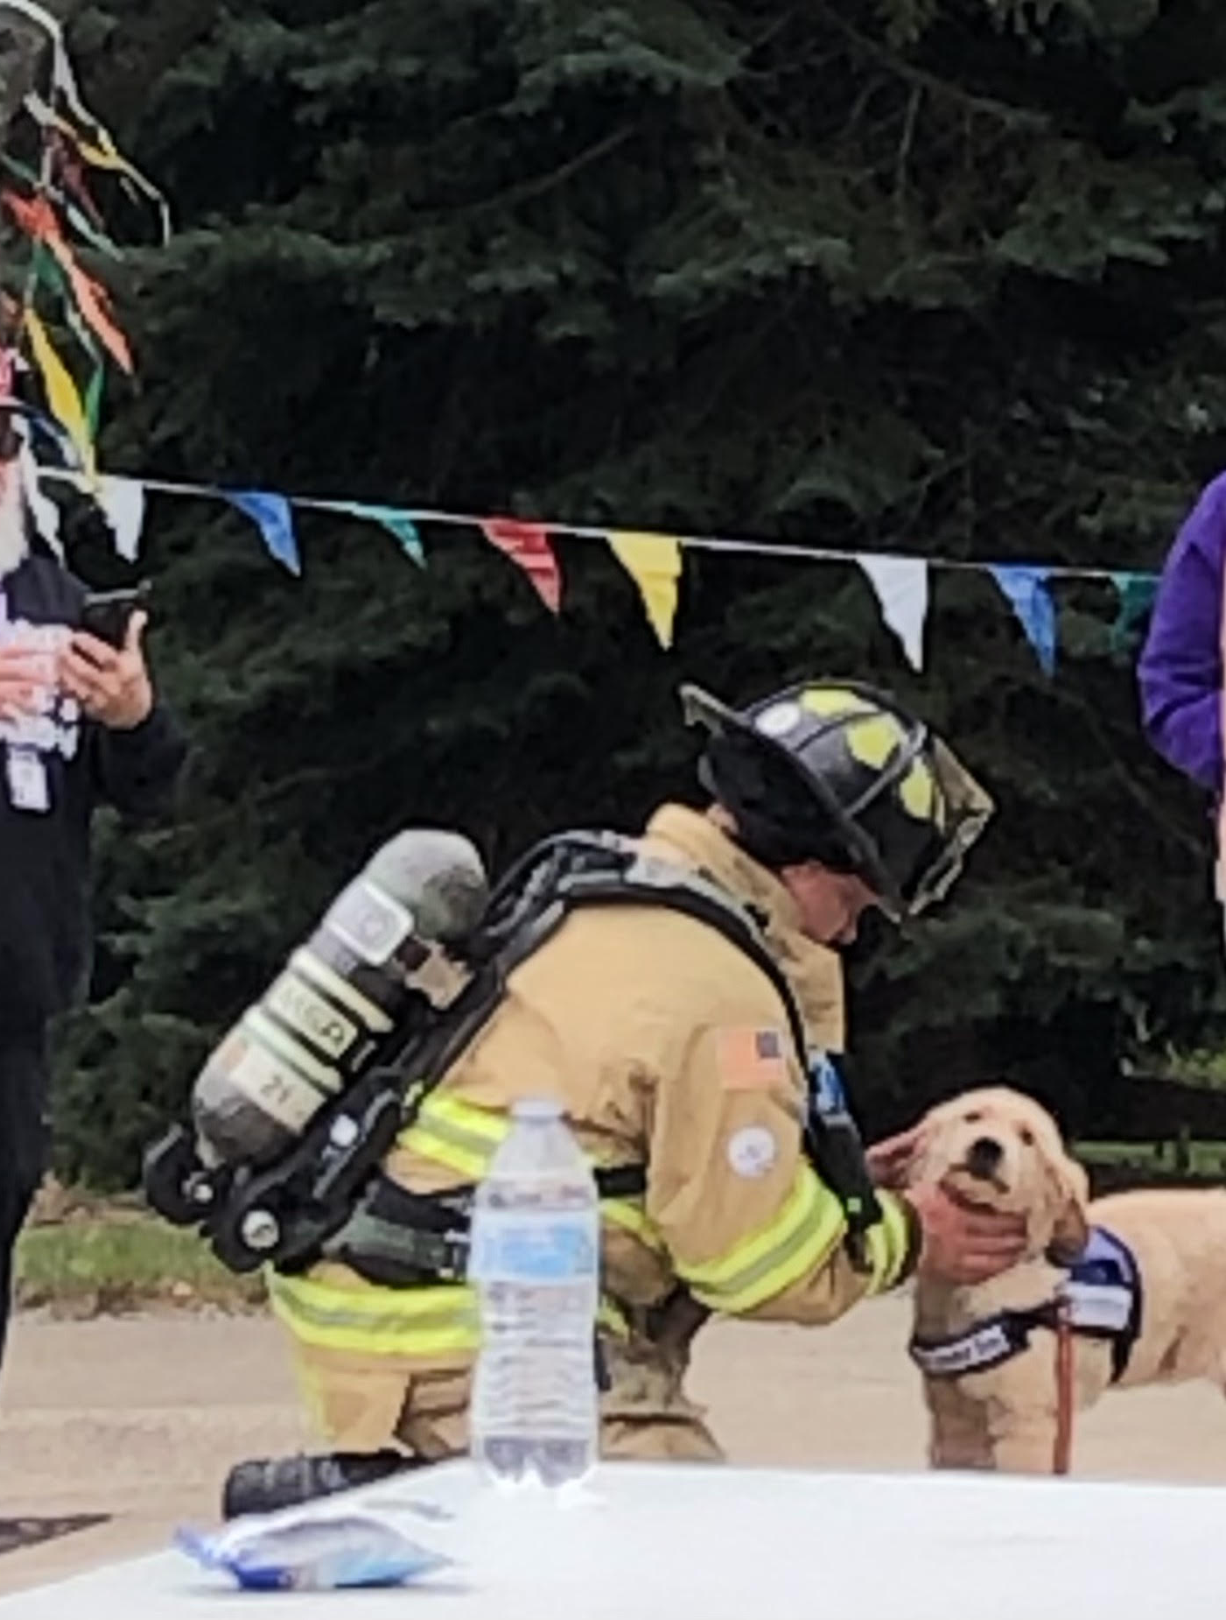
How We Communicate
Example:
E-mail Messages – Members and Events
  belviderelions@gmail.com
Web site – Club News, Events and Announcements
  www.belviderelions.org
Social Networking – Members and Club News
  Facebook: Belvidere Lions Club
  Twitter: @belviderelions1

Slide 41
Welcome to our Lions Club!
Any Questions?

